Slide 1
Module 14
Integrated Promotion Decisions
By: Dr Shahinaz Abdellatif

Slide 2
Objectives of the Session
1.To understand the promotion mix and factors influencing choice
2. To discuss the decision sequence for developing the promotion mix

Slide 3
Factors Influencing Choice Of Promotional Mix
A promotional or an integrated marketing communication (IMC) planning process as one of ‘building and reinforcing mutually profitable relationships with employees, customers, other stakeholders, and the general public by developing and coordinating a strategic communications programme that enables them to make constructive contact with the company brand through a variety of media.
The principal tools from which a marketer can choose in developing an IMC plan, comprising the promotion mix, are advertising, personal selling, sales promotion, and public relations, though there are other promotional tools, such as sponsorships, etc….

Slide 4
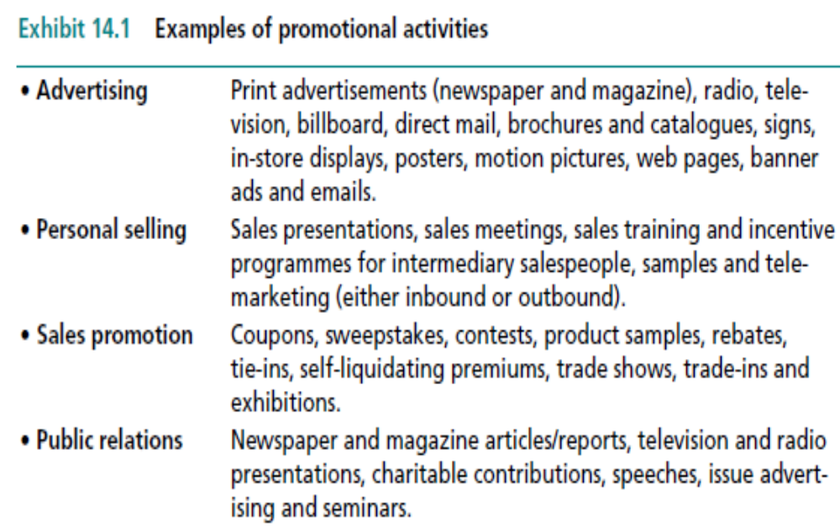
Promotional Activities

Slide 5
Factors Influencing Choice Of Promotional Mix
Promotion objectives
Resource availability & cost of promotional tools
Market size & concentration
Customer information needs
Product characteristics
Push v’s pull strategies
Segmentation & positioning strategies

Slide 6
Decision Sequence for Developing the Promotion mix
Define the audience(s) to be targeted
(1)
Set the promotional objectives
(2)
Set the promotion budget
(3)
Design the promotion mix
(4)
Evaluate the results
(5)

Slide 7
Step 1: Define the Audience(s) to Be Targeted
Segmentation decisions are especially important to the marketing communications effort because they identify who the target market is, so those planning the communications effort can identify the best ways to reach the target customers.
Making promotional decisions without a clear idea as to who the target market is can often lead to misdirection or waste of scarce marketing funds.
Sometimes promotional messages in an integrated marketing communications programme must target multiple audiences, such as for medical products.

Slide 8
Step 2: Set the Promotional Objectives
Good promotional objectives should include four key elements:
A statement defining the target audience;
A statement of how some specific aspect(s) of the audience’s perceptions, attitudes, or behaviour should change;
A statement of how quickly such a change is expected to occur; and
A statement of the degree of change required.

Slide 9
Step 3: Set the Promotion Budget
There several ways to prepare the promotion budget, most of which work from the top down (managers first determine the total amount to be budgeted and then allocate various amounts to the different mix components). The major budget-setting methods include
The percentage of sales method is the most common. The procedure consists of setting this year’s budget as a percentage of this year’s anticipated sales. Under this approach, sales determine the promotional activity versus planning to achieve some desired sales objective. Even though illogical, this method has some advantages. It is simple to calculate and is risk-averse because spending is linked to sales.
The competitive parity method sets the relative level of promotional spending equal to the firm’s market share or larger if an attempt is being made to increase share.

Slide 10
Step 3: Set the Promotion Budget
Objective-and-task method avoids most of the flaws inherent in the top-down budgeting approaches, it is the best one – though the most difficult – to use.
It essentially involves three steps – First, define promotional objectives as specifically as possible;
Second, determine the strategies and specific tasks necessary to meet those objectives; and
Third, estimate the costs of performing those tasks and budget accordingly.
The objective-and-task method has the advantage of forcing firms to set specific promotional objectives through careful analysis of the specific situation. It is most effective when the results obtained from a particular promotion activity can be measured (for instance, the awareness generated among members of the target audience or the number of persons who would be exposed to the product via sampling).

Slide 11
Step 4: Design the Promotion Mix
Designing the promotion mix is itself a three-step process.
First, marketers decide which promotion components to use: advertising, personal selling, sales promotion, and/or public relations.
Second, they choose the specific activities within each component. In advertising, this involves considering such media as TV, radio, newspapers, magazines, the Internet, or billboards. A consumer sales promotion could consist of coupons, free samples, or premiums.
Third, within each activity they must decide which specific vehicle to employ; for example, in advertising, this might require selecting a TV or radio programme, while in sales promotion they must decide about the coupon specifics – its value, size and colour, message format, and how it will be delivered.

Slide 12
Strategic Circumstances & Relative Importance of Personal Selling as a Promotional Tool
Advertising
relatively
important
Personal Selling
relatively
important
Number of customers
Buyers’ information needs
Size and importance of purchase
Post-purchase service required
Product complexity
Distribution strategy
Pricing policy
Resources available for promotion
Large
Low
Small
Little
Low
Pull
Preset
Many
Small
High
large
Much
High
Push
Negotiated
Few
Source: Adapted from David W. Cravens, Strategic Marketing (Burr Ridge, IL: Richard D. Irwin, 1987), p. 508.
Notes:
2
This chart shows situations where advertising or personal selling is more or less likely to be an important part of the marketing mix (and budget!).

Slide 13
Comparing the Merits of the
Promotion Mix Elements
Promotion mix Element | Amount of Information to be Communicated | Credibility | Control over the Message | Cost to reach one customer | Strategic suitability
Advertising | Varies: little information in a radio or a TV ad, to lots on a website | Low | Good | Low | Well-suited to a Pull Strategy
Personal Selling | Lots of information | Depends on the credibility of the company and the personality and sales skills of the salesperson | Poor, but training helps | Very high | Well-suited to a Push Strategy
Notes:
See slide

Slide 14
Comparing the Merits of the Promotion Mix Elements
Promotion mix Element | Amount of Information to be Communicated | Credibility | Control over the Message | Cost to reach one customer | Strategic suitability
Sales Promotion | Virtually no information | Not Applicable | Good | Low and Self-liquidating: generally pays for itself as the product is purchased | Consumer promotion supports a pull strategy. Trade supports a push strategy
Public Relations | Lots of information | High | Poor | Very low or nil | Supports both pull and push strategies
Notes:
See slide

Slide 15
Developing the Creative Strategy
Creative strategy derives from the product’s targeting and positioning decisions coupled with what the advertising must accomplish. From this information the major selling idea for communicating the key benefits must be developed. This, in turn, generates a strategy statement – often referred to as a copy platform.
Deciding on the major selling idea or theme is the essence of the creative strategy process since it dictates the nature and scope of the various messages that collectively make up an advertising campaign and it delivers on the positioning decisions.

Slide 16
Copy Platform Contents
Basic issue or problem advertising must address.
• Advertising objective.
• Target audience.
• Major selling idea – or key benefits.
• Creative strategy statement (campaign theme, appeal and execution technique).
• Supportive information.

Slide 17
Step 5: Evaluate the Results
This step involves finding out whether the objectives of the promotional activity have been met – usually via marketing research.
For example, in advertising a new consumer product, the company could conduct a telephone survey after the promotional campaign had run for a designated period to determine whether the objective of generating a certain level of awareness among members of the target audience had been achieved.

Slide 18
Measuring Advertising Results
Management must know to what extent the message was received, understood, and believed by the target audience, as well as what effect it had on the behaviour of the receiver (trial, repeat buying).
Message (copy) testing typically is concerned with alternative ways to present a message to the target audience.
There are types of tests made before the message is released on a full-run basis and tests done after the copy is run in the prescribed media.

Slide 19
Before tests
Recall tests of proposed print ads are inserted into a simulated magazine and respondents are told to read whatever interests them. After doing so, they are asked to ‘play back’ ads they remember. They are also asked questions about ad credibility and product usage. Using the results, researchers can determine the extent to which the message got through and to what extent it achieve the communicator’s objective(s). Unfortunately, recall scores too often reflect brand’s popularity rather than message content.
Sales tests as administered by commercial research firms measure the effects of TV commercials through the use of consumer panels located in a number of small cities. Purchases are recorded electronically by scanners at supermarket checkout counters by panel members using special ID cards. BehaviorScan can insert test TV commercials into TV programmes at the individual panel household level. They select household samples on the basis of their purchase behaviour history. Thus, the consumer panel becomes a single source of both purchase and viewing behaviour, thereby enhancing its value. It is possible to measure the sales effect of one copy treatment against another based on actual purchase data.

Slide 20
After tests
Measuring the effects of an advertising message after it has run is difficult because the results are confounded by the effects of the media used and the frequency with which the audience received the message.
After tests tend to measure the effectiveness of the total advertising effort. Here we look at only those after tests used primarily to measure message effects. Thus, for example, BMW’s advertising agency reported that consumer research showed that consumers were getting the right message – namely, that a BMW is not only dynamic, but comfortable and affordable as well.
Advertisers design after tests in a number of ways, and they all rely on the respondent’s memory, which raises the problem of how soon after running the ad the measurement should be taken. Also, testing that relies on a single measure in time does not reflect the learning that occurs with repeated exposure.

Slide 21
After tests
Recognition tests are the most popular post exposure testing method for print media. Advertisers design these tests to measure the extent to which advertising copy is noted and read. Field workers interview people who say they have read a given issue of a magazine. Each respondent goes through the issue pointing out what was seen and read. When the respondent reports seeing an ad, the interviewer asks which parts were read. The interviewer starts each interview at a random point within the issue, so that the ratings are not affected by respondent fatigue.
Recall tests are another common way to measure the effectiveness of an advertising message, especially a TV commercial, after it has been run. Respondents are typically aided in their recall-aided test. Interviewers show list of the advertisers and brands presented and ask which ones they have seen recently. Interviewers proceed to obtain playbacks of these ads from the respondents.

